Slide 1

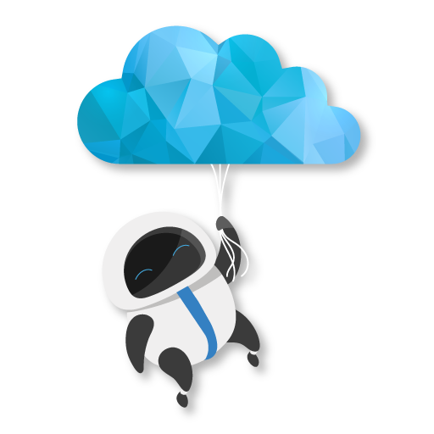

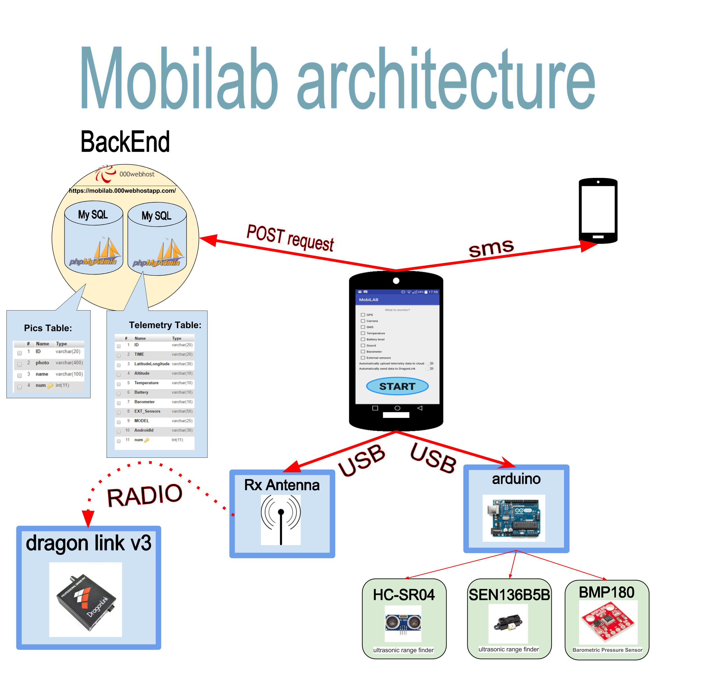
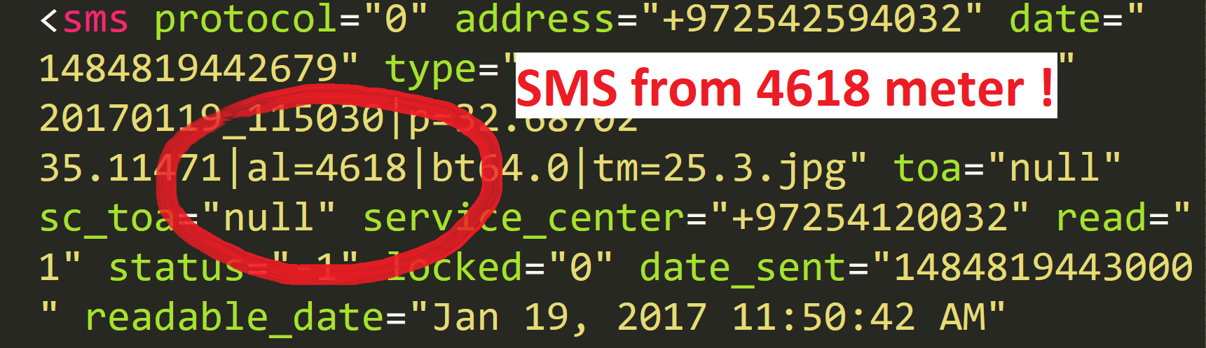
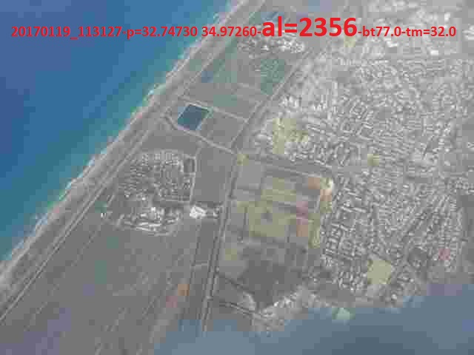
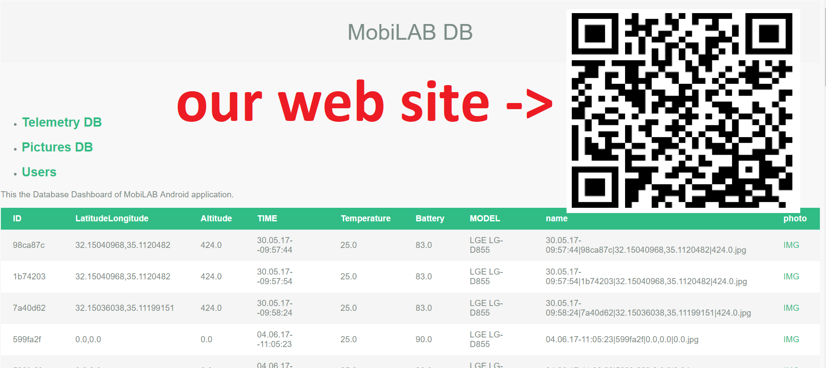
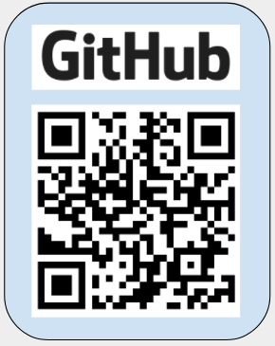
MobiLAB is an Android Application that will monitor, record and communicate with all of your android sensors in one place.
The Need
During the process of investigating helpful technologies to autonomous vehicles, we found that there is a real need in a stand alone system that hold the ability to gather and process real-time information and telemetry that connected to it, such as: camera, microphone, barometer, GPS location, temperature, pictures ,etc…
The ability to process this information and send it to the ground on real-time parallelly to send this information to a connected cloud service and of course save this information on local storage, give to the autonomous vehicle and specifically UAV’s new strong and important abilities.
The Technology
The technology MobiLAB offers can get the market to developing new autonomous vehicles with new abilities that never seen up for today, and also improvement of existing systems on existing autonomous vehicles that not carrying mobile lab systems such as describe above.
The mobile lab designed to include two separated components, the first will be the system UI Application for an Android devices which will give the user controlling abilities on the lab settings.
And the second will be an Android background Service which will run on the background of the android device and will be the authority to record data from the sensors, gather important information, analyze it and send the data to the ground and cloud control stations.

